Slide 1
EMBEDDED SYSTEM DESIGN PROJECT ESE-4009 TESTING THE HARDWARE COMPONENTS
Submitted by:-
Gurdeep Singh (C0751603)
EMBT 4th SEM

Slide 2
IoT based Visitor Counter using Beaglebone Black
LIST OF HARDWARE COMPONENTS USED IN THE PROJECT ARE LISTED BELOW:
BeagleBone Black
Ultrasonic sensors
Temperature Sensor
LCD (16x2)
Buzzer
Wi-Fi Module
Motor Driver
DC Motor

Slide 3
TESTING OF HARDWARE COMPONENTS
Testing is needed to ensure that every component of a system is operating as it should, and that the system is performing exactly in accordance with the specific local requirements.
Hardware testing is usually more detailed and thorough than verification.
A comprehensive structured testing program is one that ensures that all aspects of a system are tested.
This is especially important for key systems such as electronic voting systems.

Slide 4
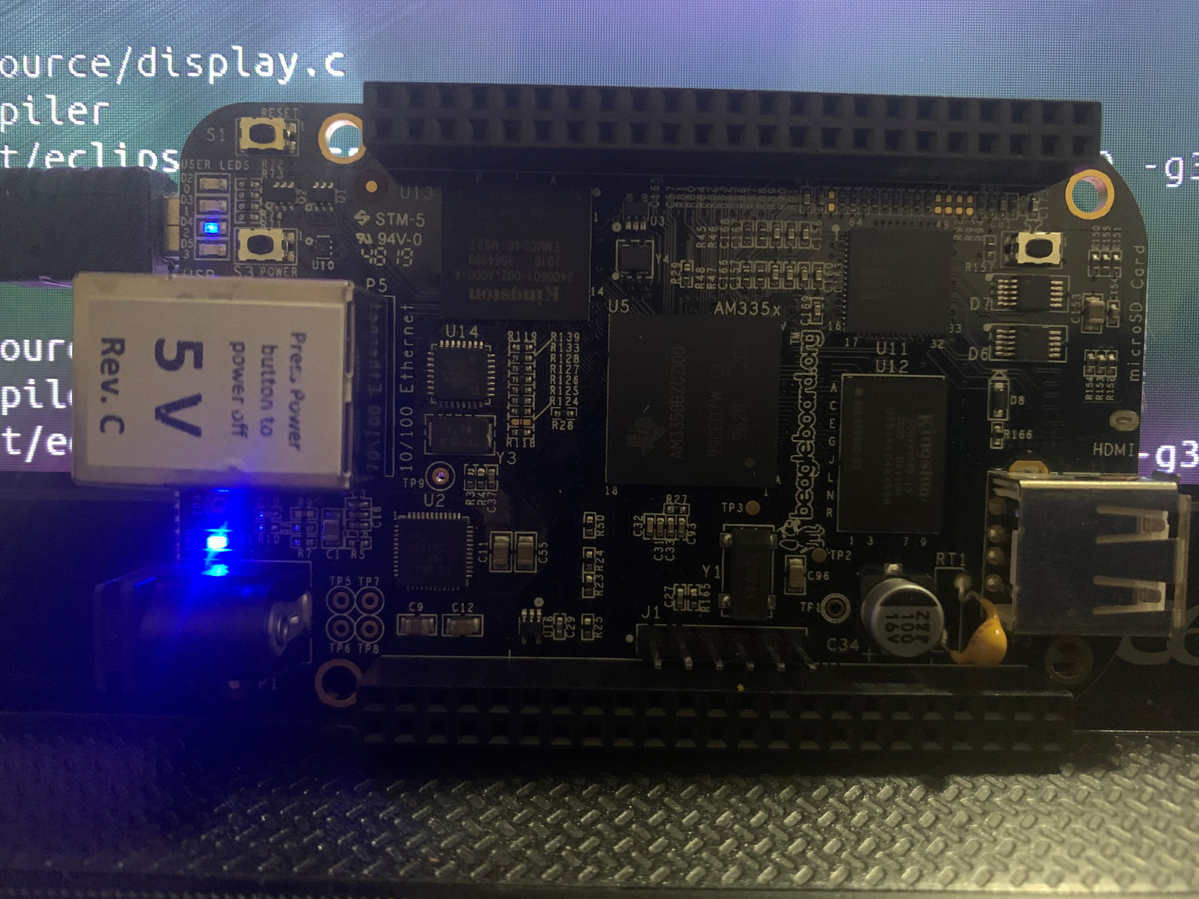
Beaglebone

Slide 5
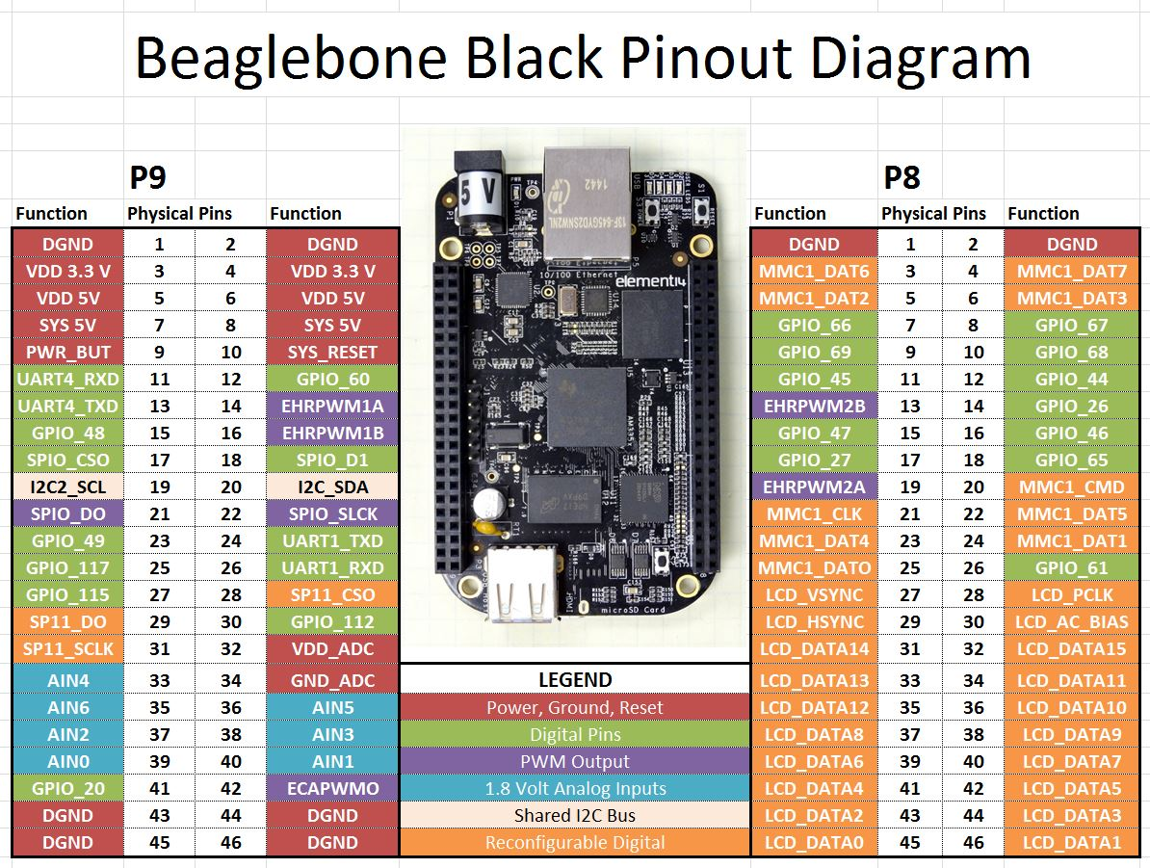

Slide 6
Beaglebone is compact, low-cost, open-source Linux computing platforms that can be used to build complex applications that interface high-level software and low-level electronic circuits.
Beaglebone Black Rev C is a development kit based on an AM335x processor which integrates an ARM Cortex™-A8 core operating at up to 1GHz and has abundant peripheral devices.
Testing of beaglebone black Rev C
Beaglebone black rev c is the main controller used in this project.
For testing beaglebone, we should first run application in it.
There are several steps and commands that should be followed in order to test whether the beaglebone is working or not.
Commands for running an application are explained from next slide.

Slide 7
Steps to load and run application in the BeagleBone black:
Write and debug the code on the desktop/host machine using the Eclipse IDE.
Connect the BeagleBone with the host system (computer/laptop) using USB cable.
Login into BeagleBone using the command: ssh 192.168.7.2 – l debian
It will ask for password then enter “temppwd”.
Make the source code into a compressed file using tar or gzip.
Using sftp protocol type the command: sftp debian@192.168.7.2 and send the source code into the beaglebone using the put command: sftp > put filename
Uncompress the file received in beaglebone
Compile the source code sent into beaglebone using GCC
Finally run the source code in beaglebone

Slide 8
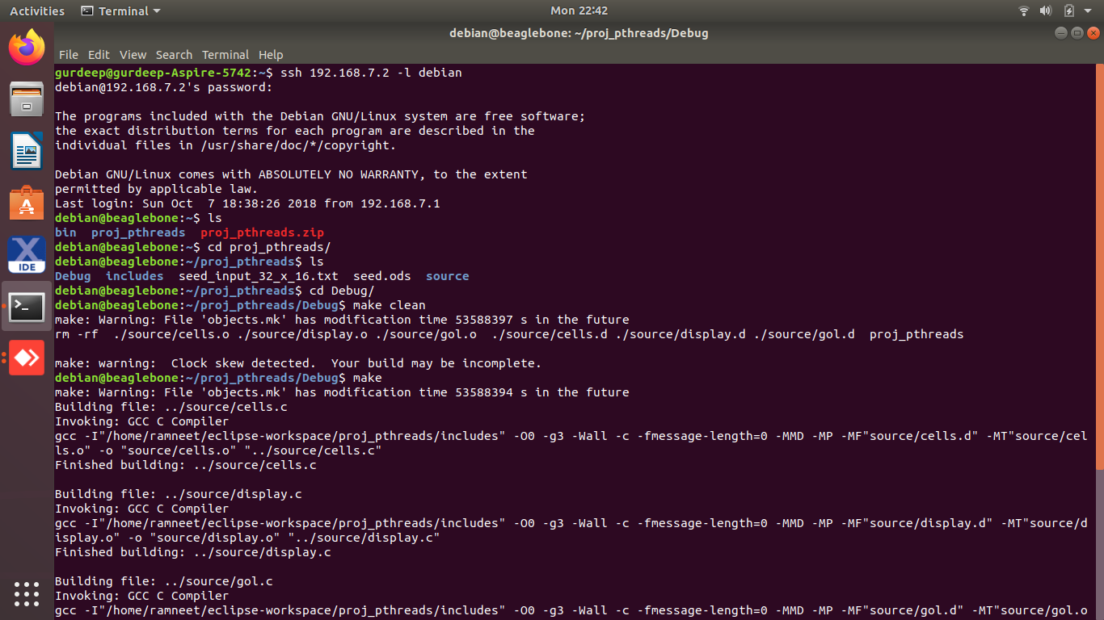

Slide 9
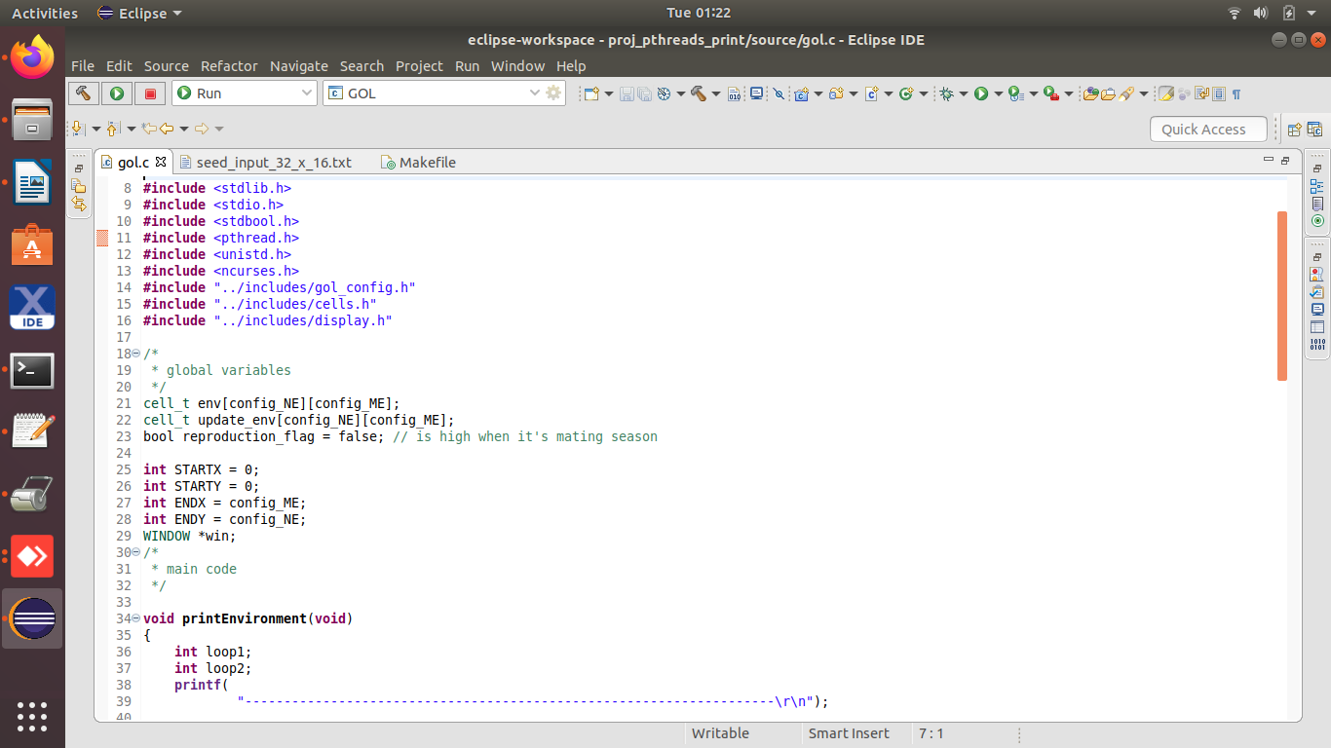
Screenshots of Game of life code used for testing of beaglebone black

Slide 10
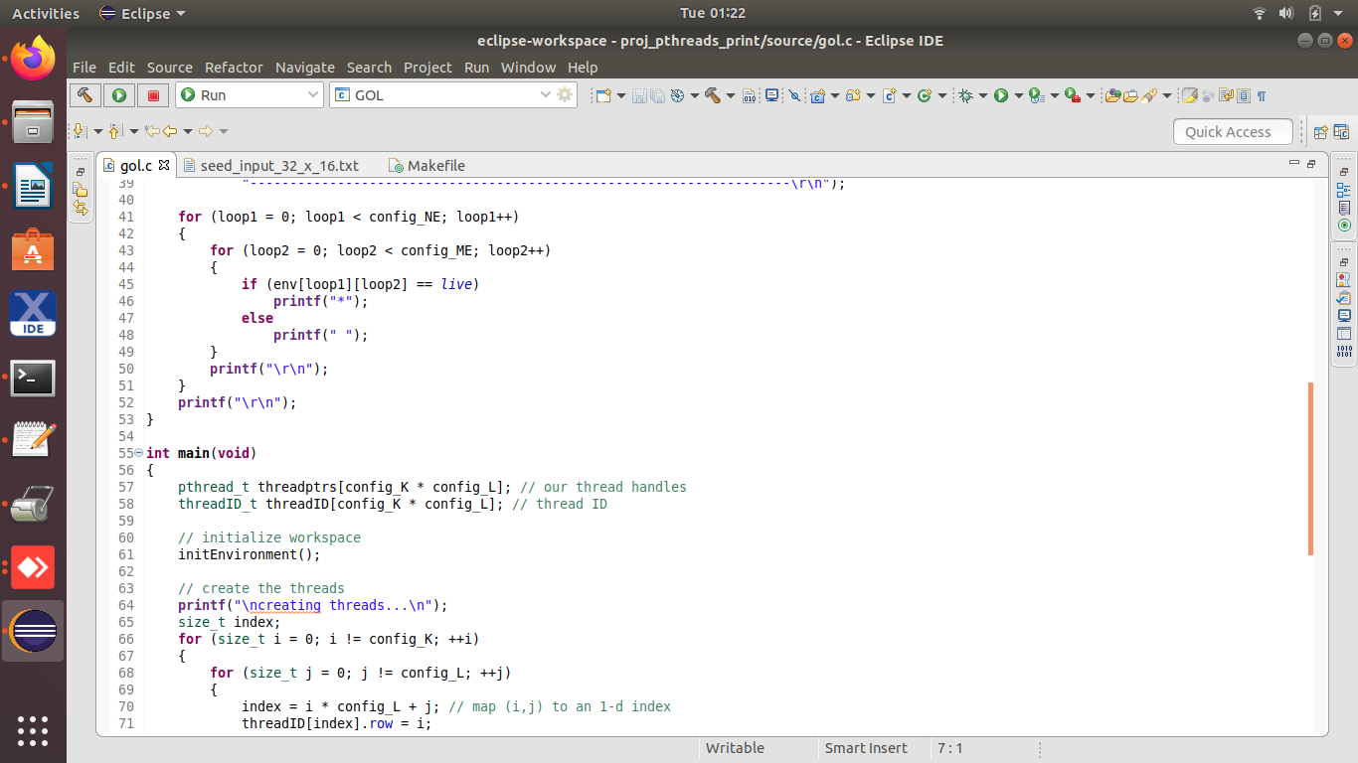

Slide 11
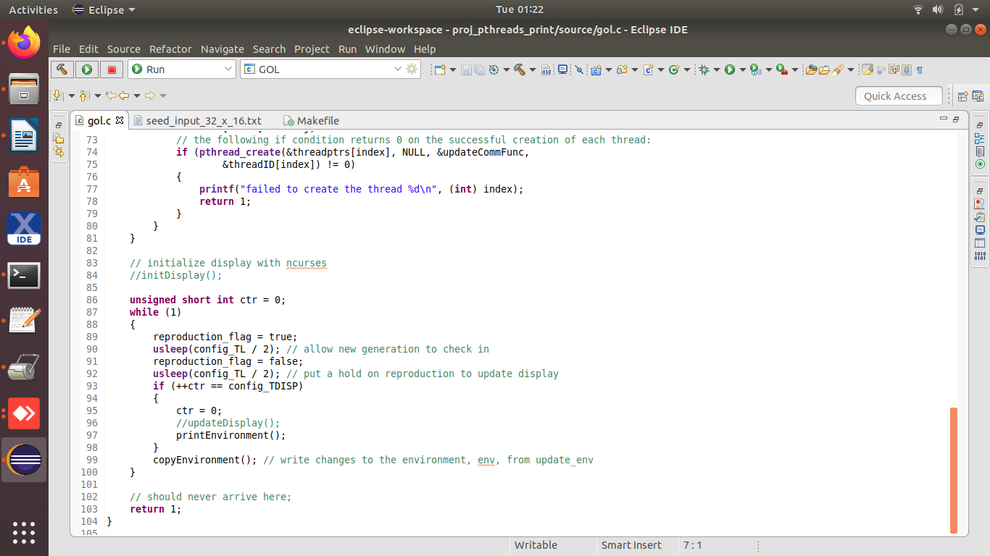

Slide 12
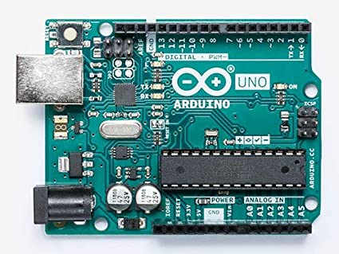
Arduino UNO

Slide 13
The Arduino integrated development environment is a cross platform application which supports various operating system including Windows and Linux.
It is used to write programs written in C or C++ programming languages and upload these programs to Arduino compatible boards.
The source code for the IDE is released under the GNU General Public License, version 2.
The Arduino IDE supports the languages C and C++ using special rules of code structuring.
With the rising popularity of Arduino as a software platform, other vendors started to implement custom open source compilers and tools that can build and upload sketches to other microcontrollers that are not supported by Arduino's official line of microcontrollers.

Slide 14
Features:
It is an open source software that is mainly used for writing and compiling the code into the Arduino Module.
Arduino boards can read analog or digital input signals from different sensors and turn it into an output such as activating a motor, turning LED on/off, connect to the cloud and many other actions.
We can control our board functions by sending a set of instructions to the microcontroller on the board via Arduino IDE.
The Arduino IDE uses a simplified version of C or C++, making it easier to learn to program. It consists of void setup() and void loop() part
In void setup() code will only run once and that will be at the beginning of our program.
In void loop() code will repeat over and over again.
The main code, also known as a sketch, created on the IDE platform will ultimately generate a Hex File which is then transferred and uploaded in the controller on the board.

Slide 15
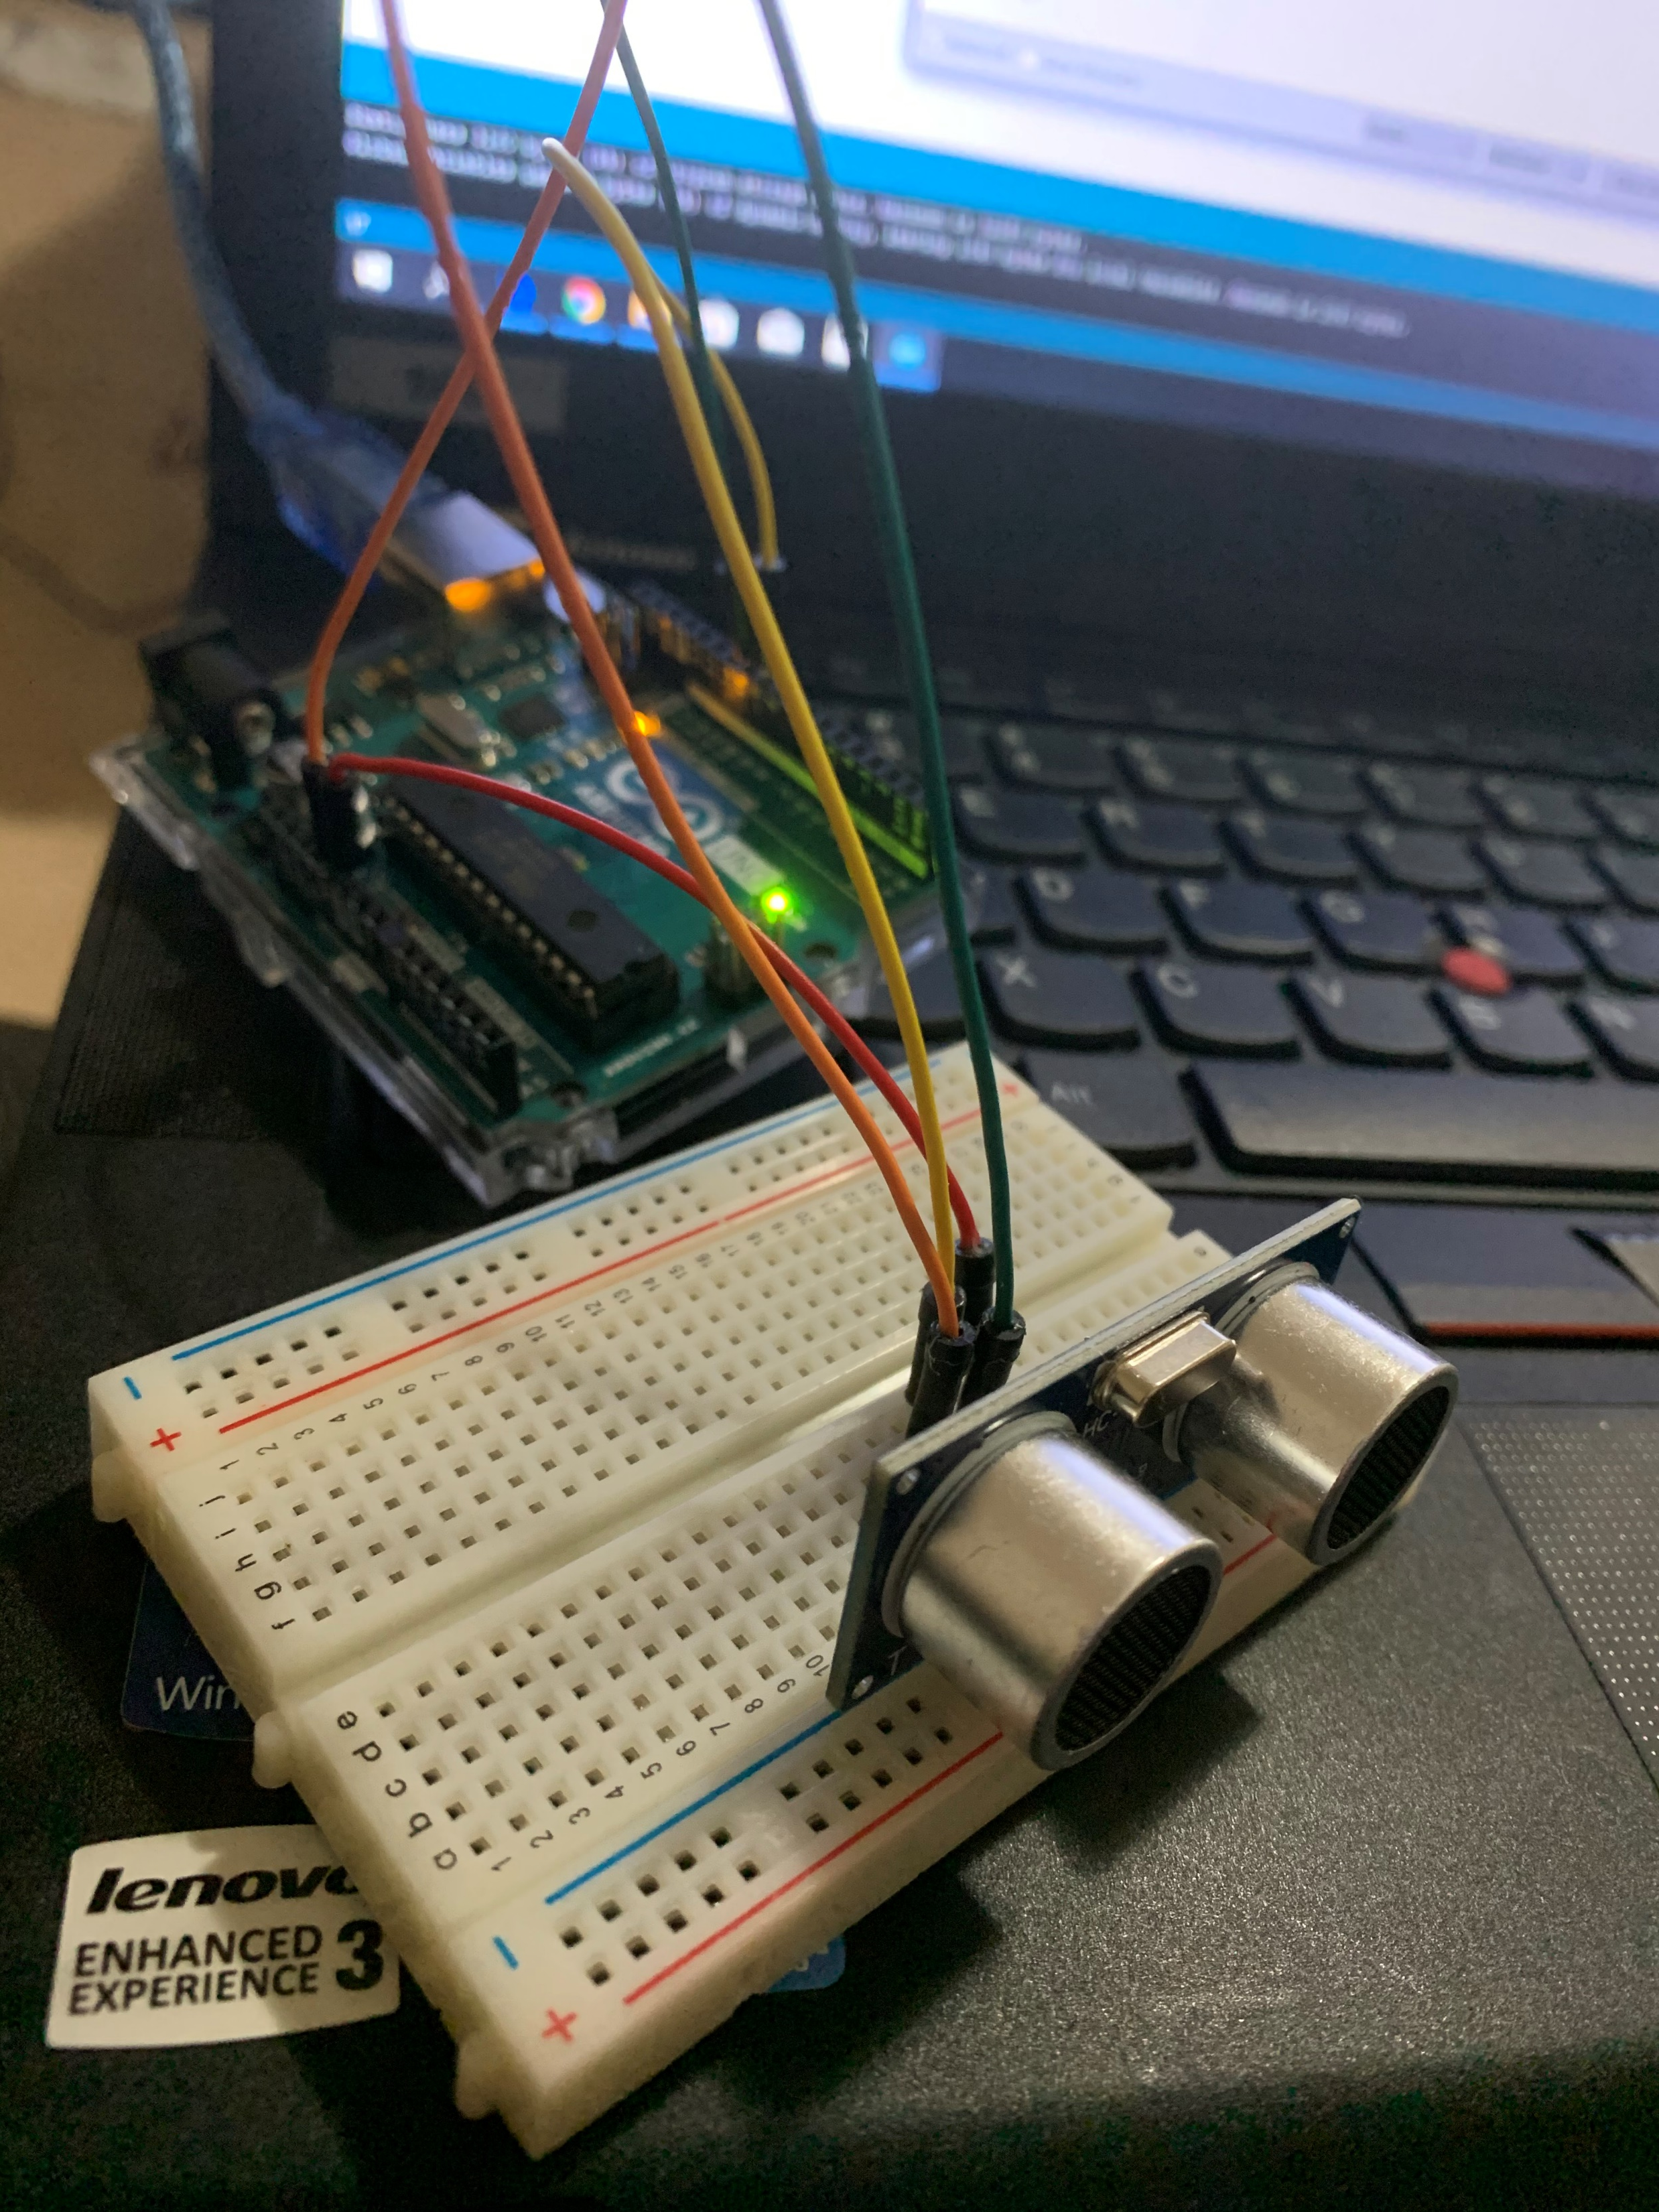
Ultrasonic sensor

Slide 16
Ultrasonic ranging module HC - SR04 provides 2cm - 400cm non-contact
measurement function, the ranging accuracy can reach to 3mm.
The modules includes ultrasonic transmitters, receiver and control circuit.
The basic principle of work:
(1) Using IO trigger for at least 10us high level signal
(2) The Module automatically sends eight 40 kHz and detect whether there
is a pulse signal back.
(3) IF the signal back, through high level , time of high output IO duration
is the time from sending ultrasonic to returning.
Test distance = (high level time×velocity of sound (340M/S) / 2.
This sensor has additional control circuitry that can prevent inconsistent "bouncy" data depending on the application.

Slide 17
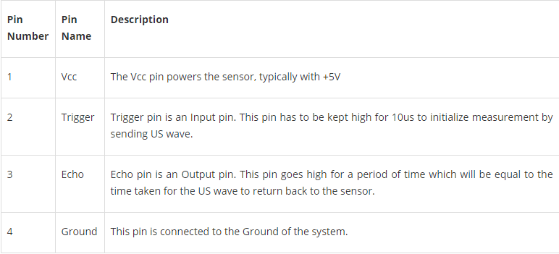

Slide 18
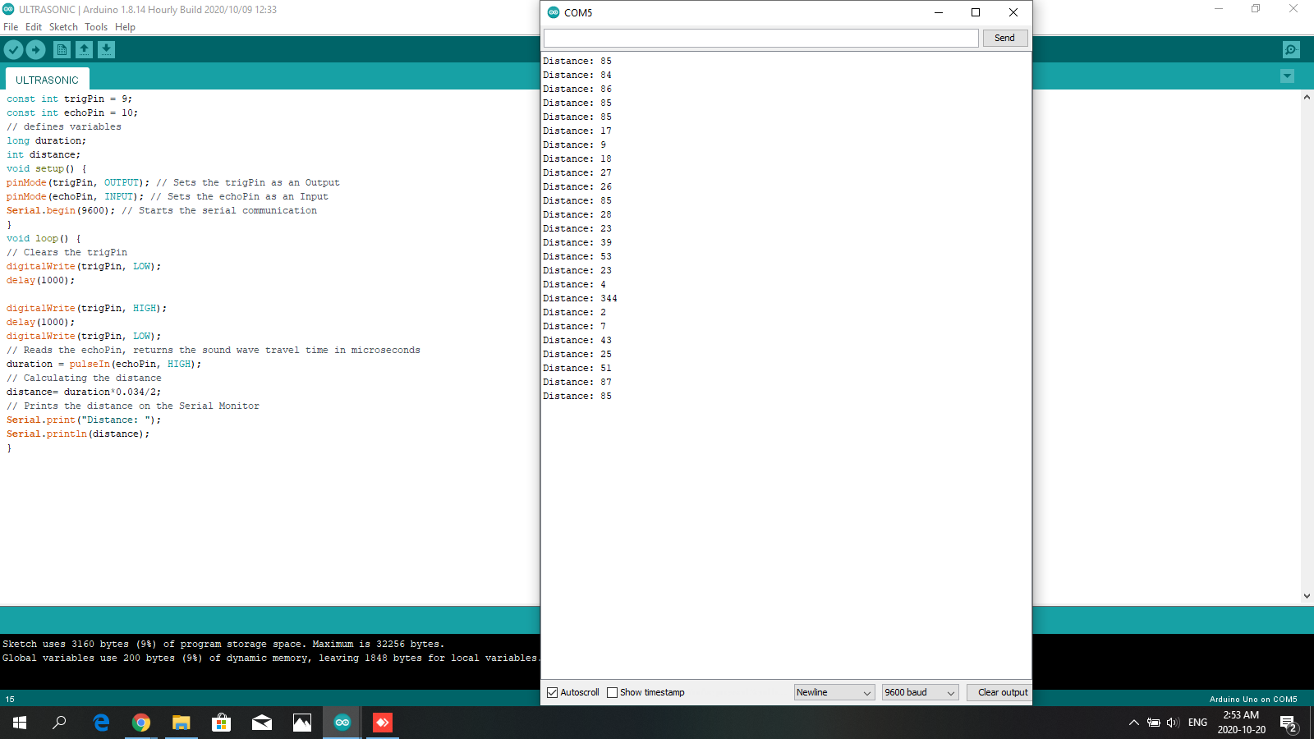
Testing code and result

Slide 19
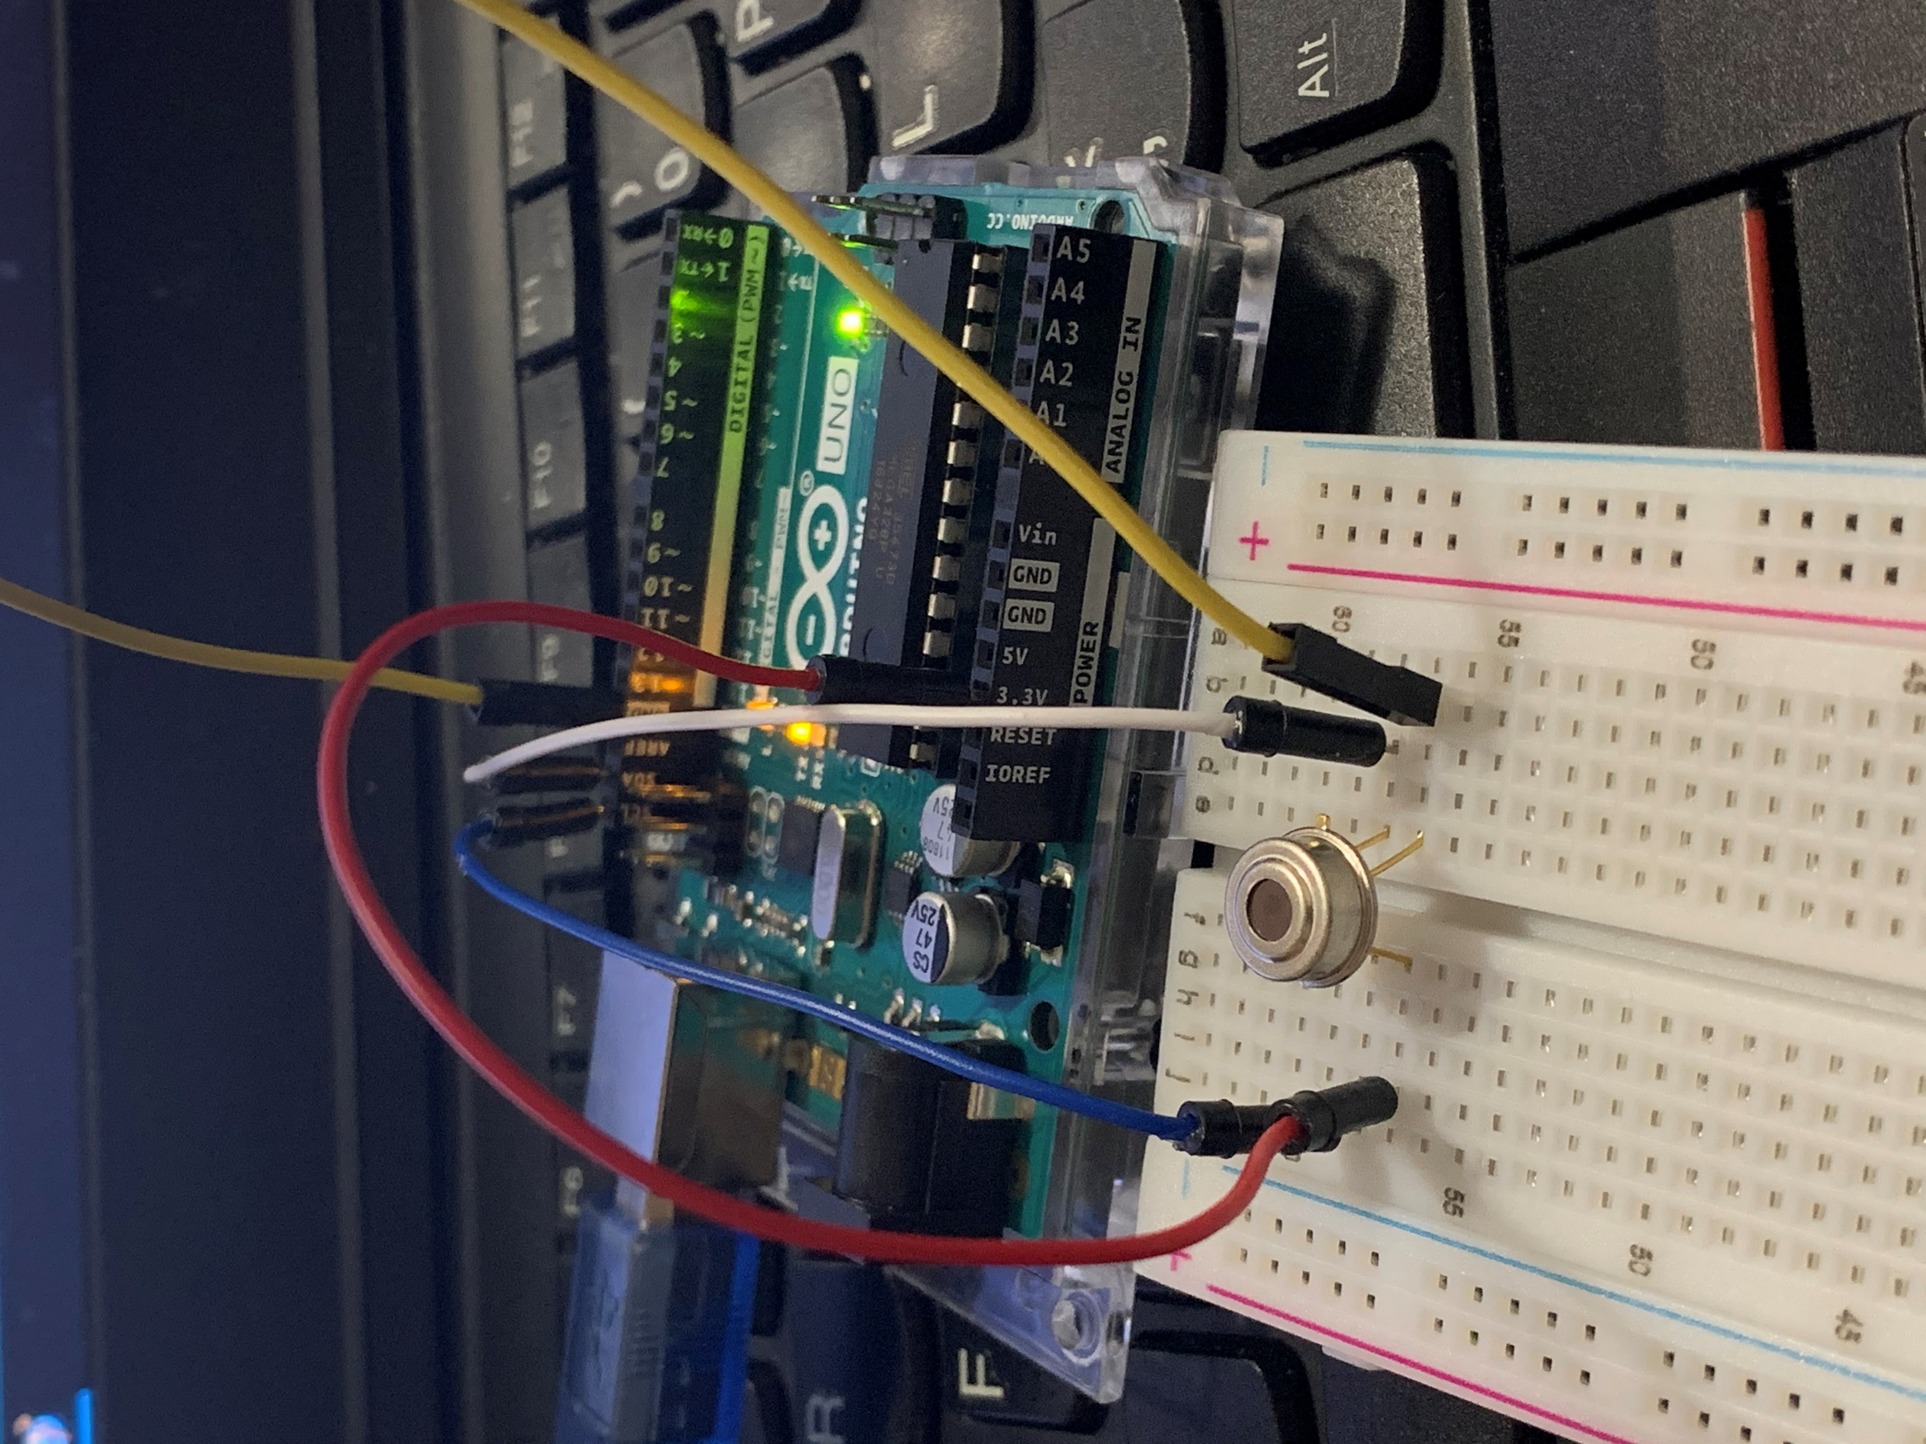
Temperature Sensor

Slide 20
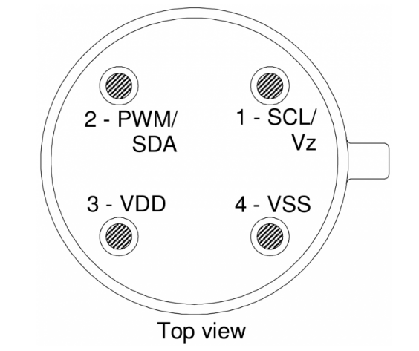
Pinout diagram

Slide 21
MLX90614 is an infrared thermometer designed for non-contact temperature sensing.
An internal 17-bit ADC and a powerful DSP contribute to the MLX90614's high accuracy and resolution.
It has a huge number of applications including body temperature measurement and movement detection.
The MLX90614 provides two methods of output: PWM and SMBus (i.e. TWI, I²C). The 10-bit PWM output provides a resolution of 0.14°C, while the TWI interface has a resolution of 0.02°C.
The MLX90614 is factory calibrated in wide temperature ranges: -40 to 85°C for the ambient temperature and -70 to 382.2°C for the object temperature.
The measured value is the average temperature of all objects in the Field Of View of the sensor. The MLX90614 offers a standard accuracy of 0.5°C around room temperatures.

Slide 22
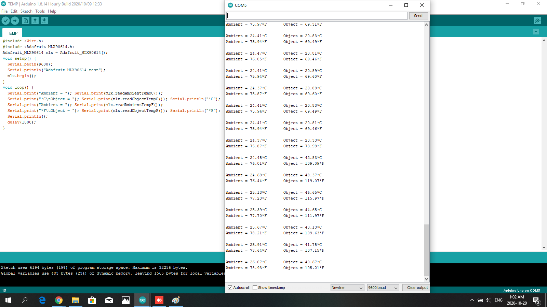

Slide 23
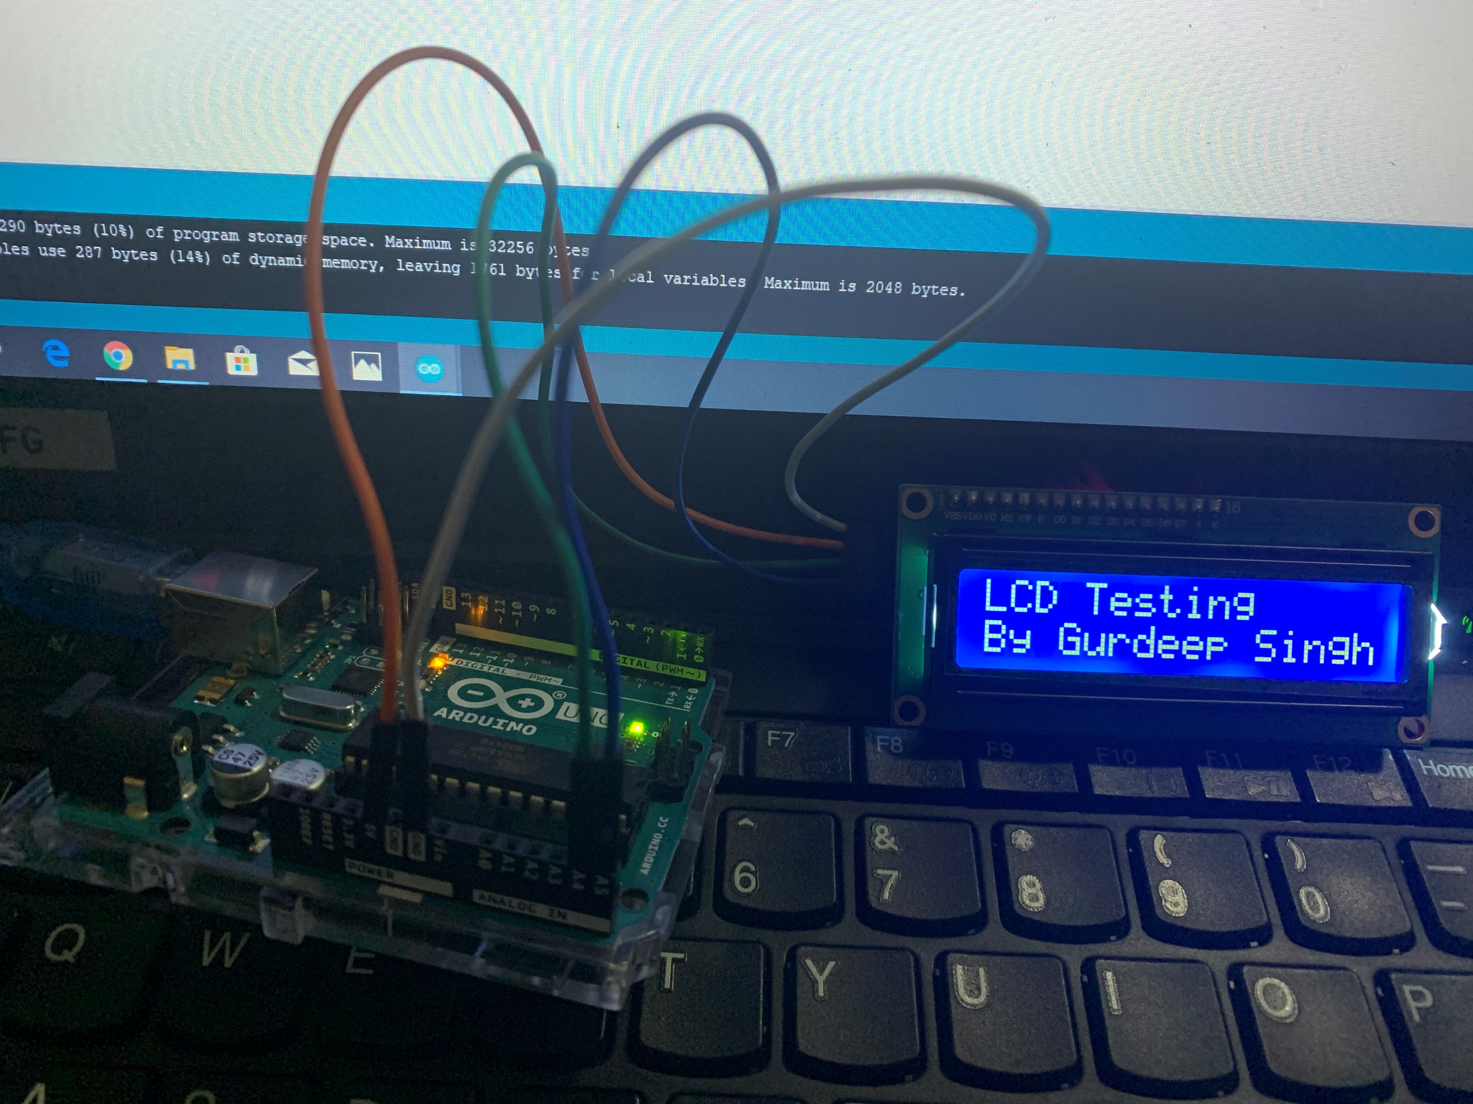
LCD (16x2)

Slide 24
Operating Voltage is 4.7V to 5.3V
Current consumption is 1mA without backlight
Alphanumeric LCD display module, meaning can display alphabets and numbers
Consists of two rows and each row can print 16 characters.
Each character is built by a 5×8-pixel box
Can work on both 8-bit and 4-bit mode
It can also display any custom generated characters
Available in Green and Blue Backlight

Slide 25
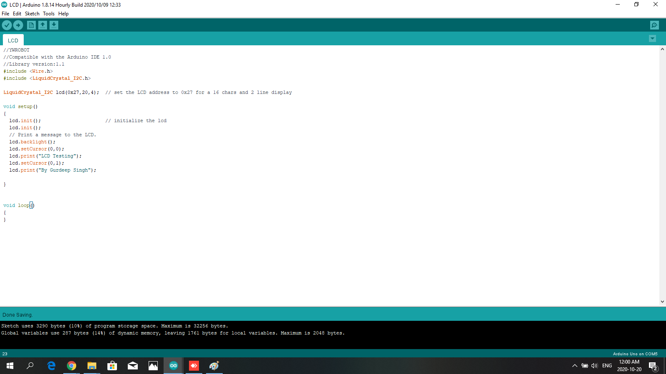

Slide 26
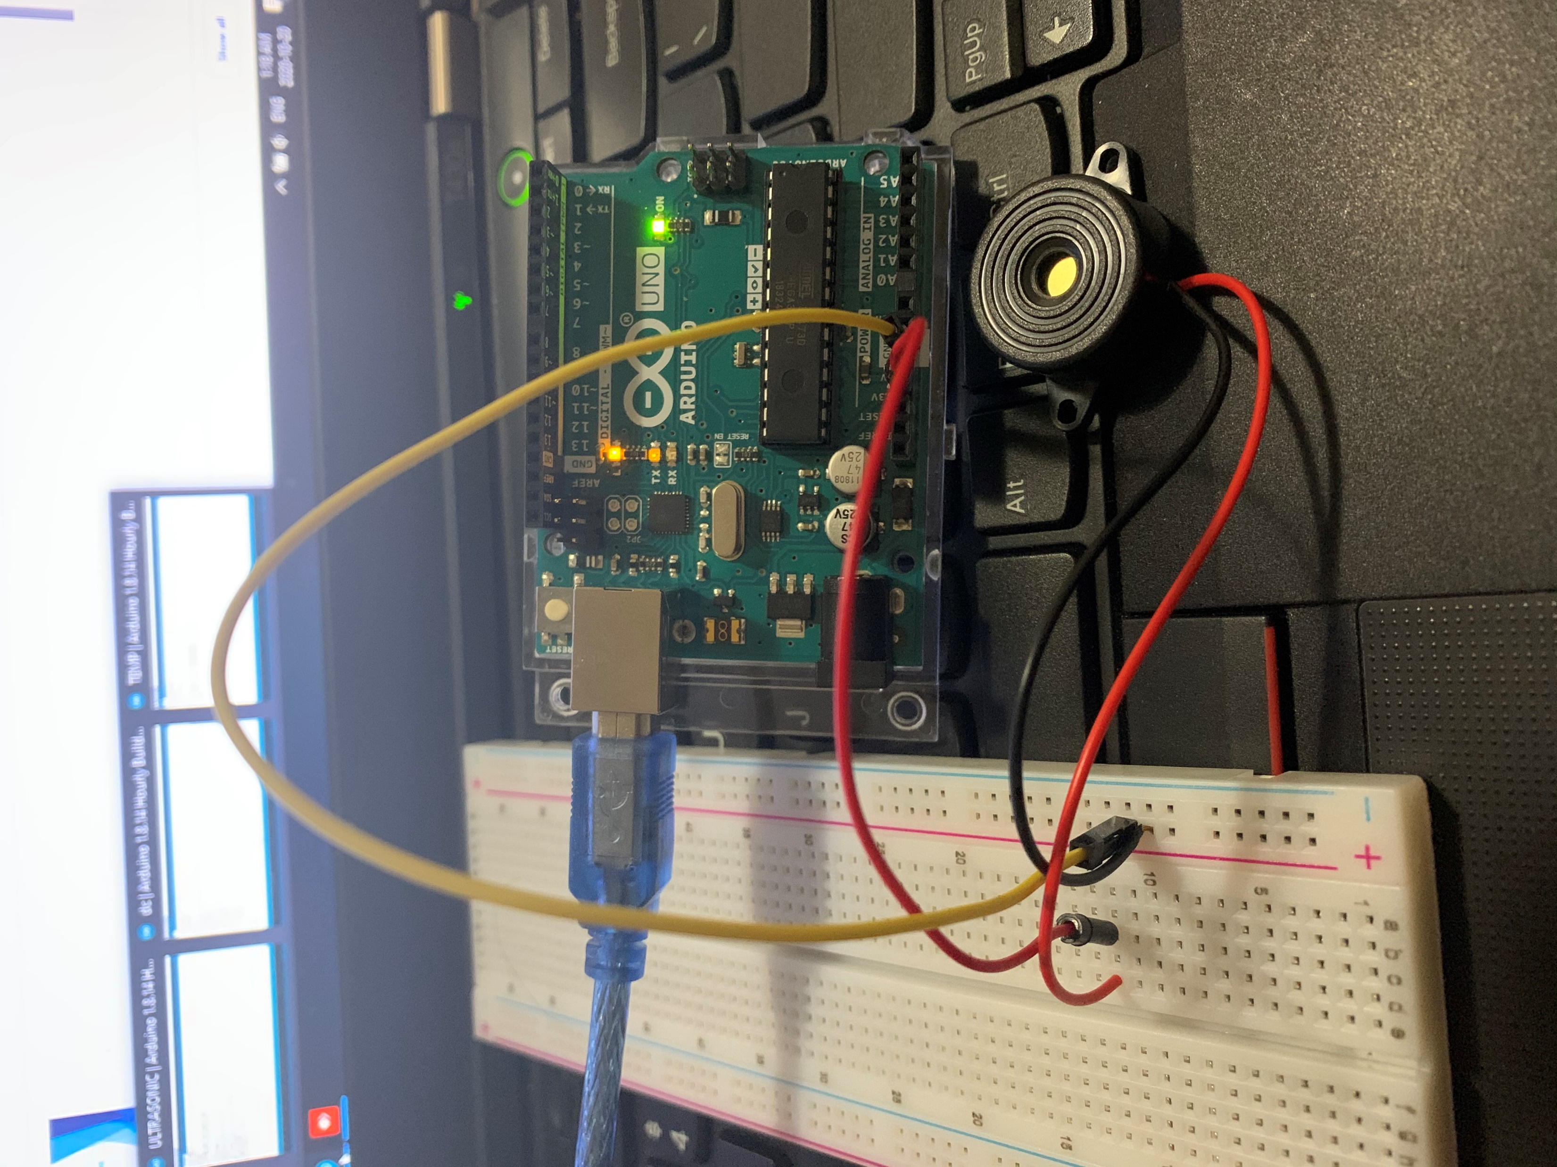
Buzzer

Slide 27
A buzzer or beeper is an audio signalling device, which may be mechanical, electromechanical, or piezoelectric (piezo for short).
Typical uses of buzzers and beepers include alarm devices, timers, and confirmation of user input such as a mouse click or keystroke
Buzzer has 2 wires i.e positive and negative.
Positive is connected to 3.3V power supply from Arduino.
Negative is connected to ground of arduio.
After connections are successfully done, code is uploaded through Arduino ide.

Slide 28
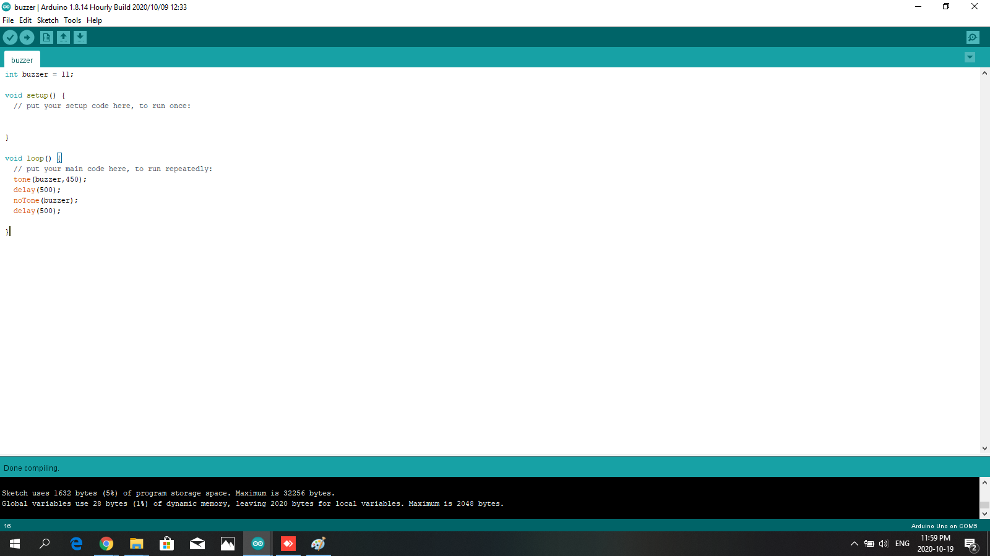

Slide 29
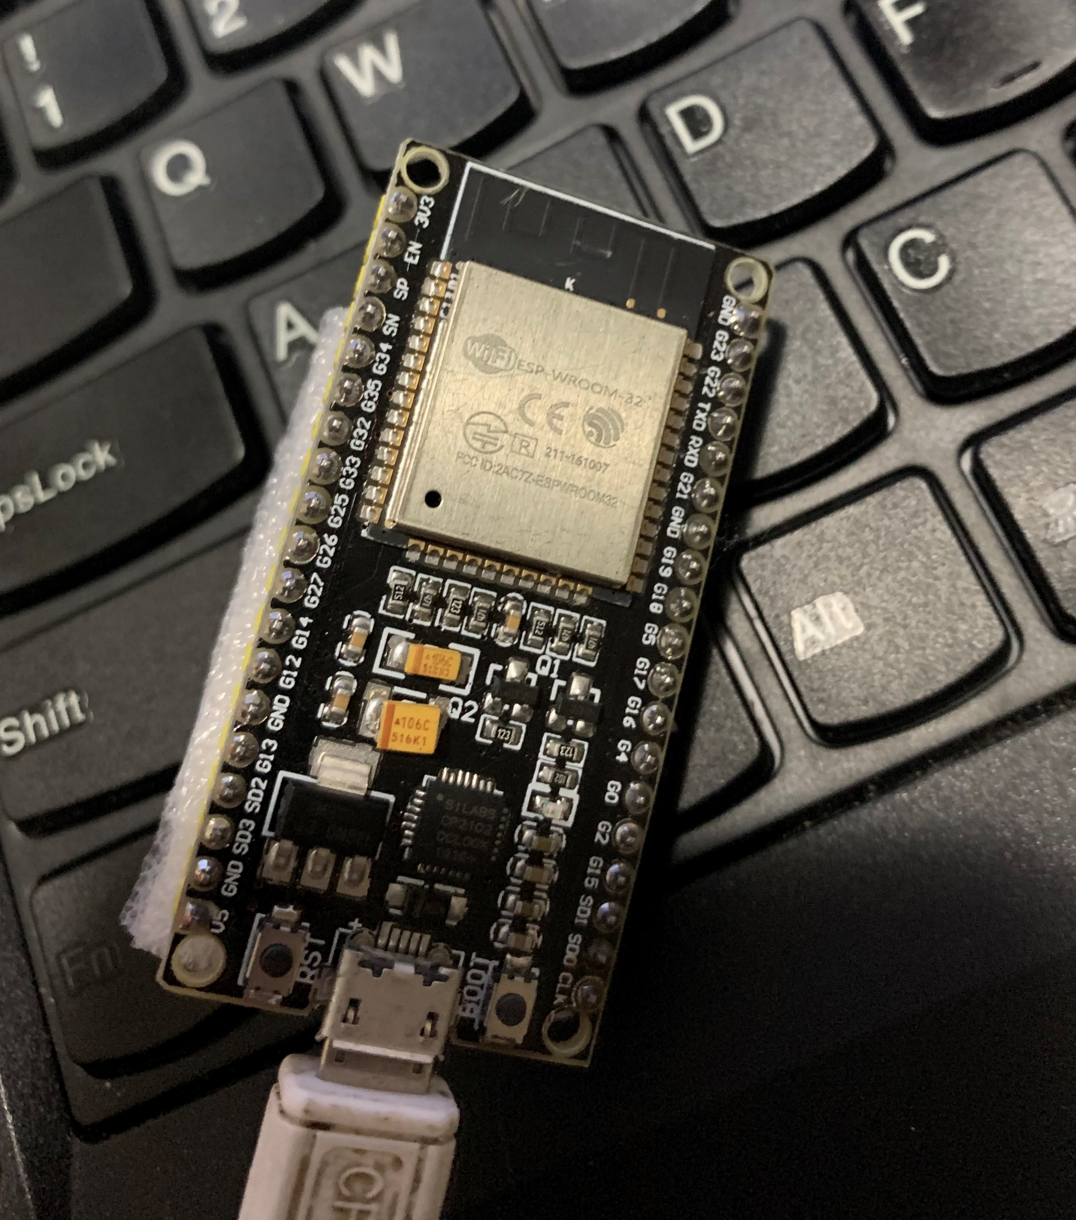
Wifi module

Slide 30
ESP32 is a series of low-cost, low-power system on a chip microcontrollers with integrated Wi-Fi and dual-mode Bluetooth.
The ESP32 series employs a Tensilica Xtensa LX6 microprocessor in both dual-core and single-core variations and includes built-in antenna switches, RF balun, power amplifier, low-noise receive amplifier, filters, and power-management modules.
ESP32 is created and developed by Espressif Systems, a Shanghai-based Chinese company, and is manufactured by TSMC using their 40 nm process.
It is a successor to the ESP8266 microcontroller

Slide 31
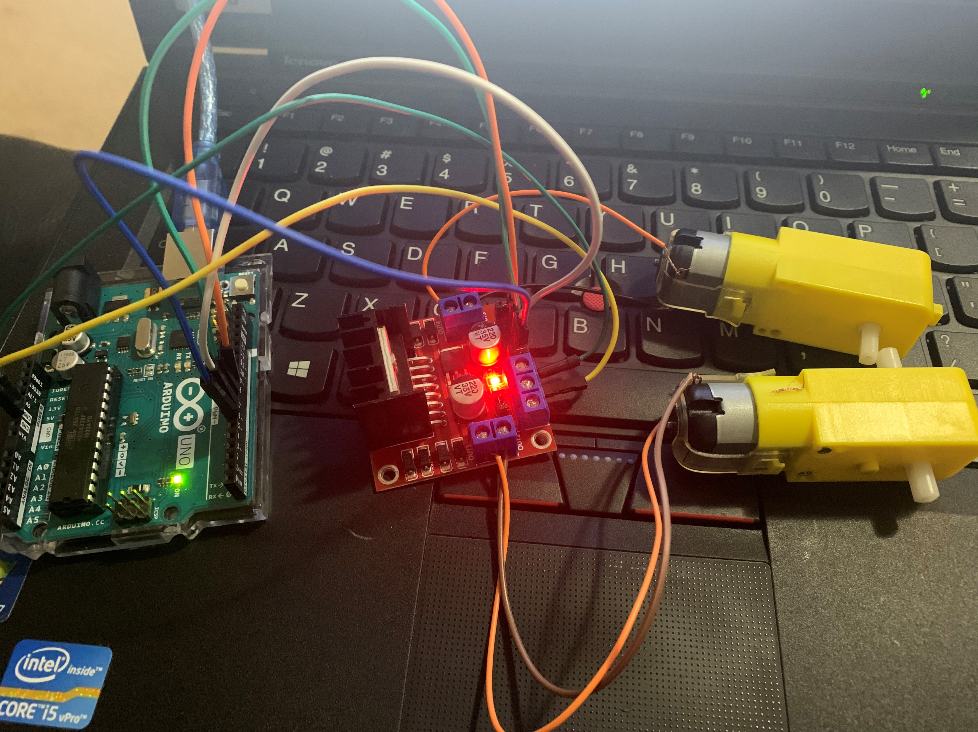
DC motor and driver

Slide 32
An electric motor is a device used to convert electricity into mechanical energy—opposite to an electric generator. They operate using principles of electromagnetism, which shows that a force is applied when an electric current is present in a magnetic field. Motors are used for several applications.
Rated Voltage: 12V & Speed: 10RPM.

Slide 33
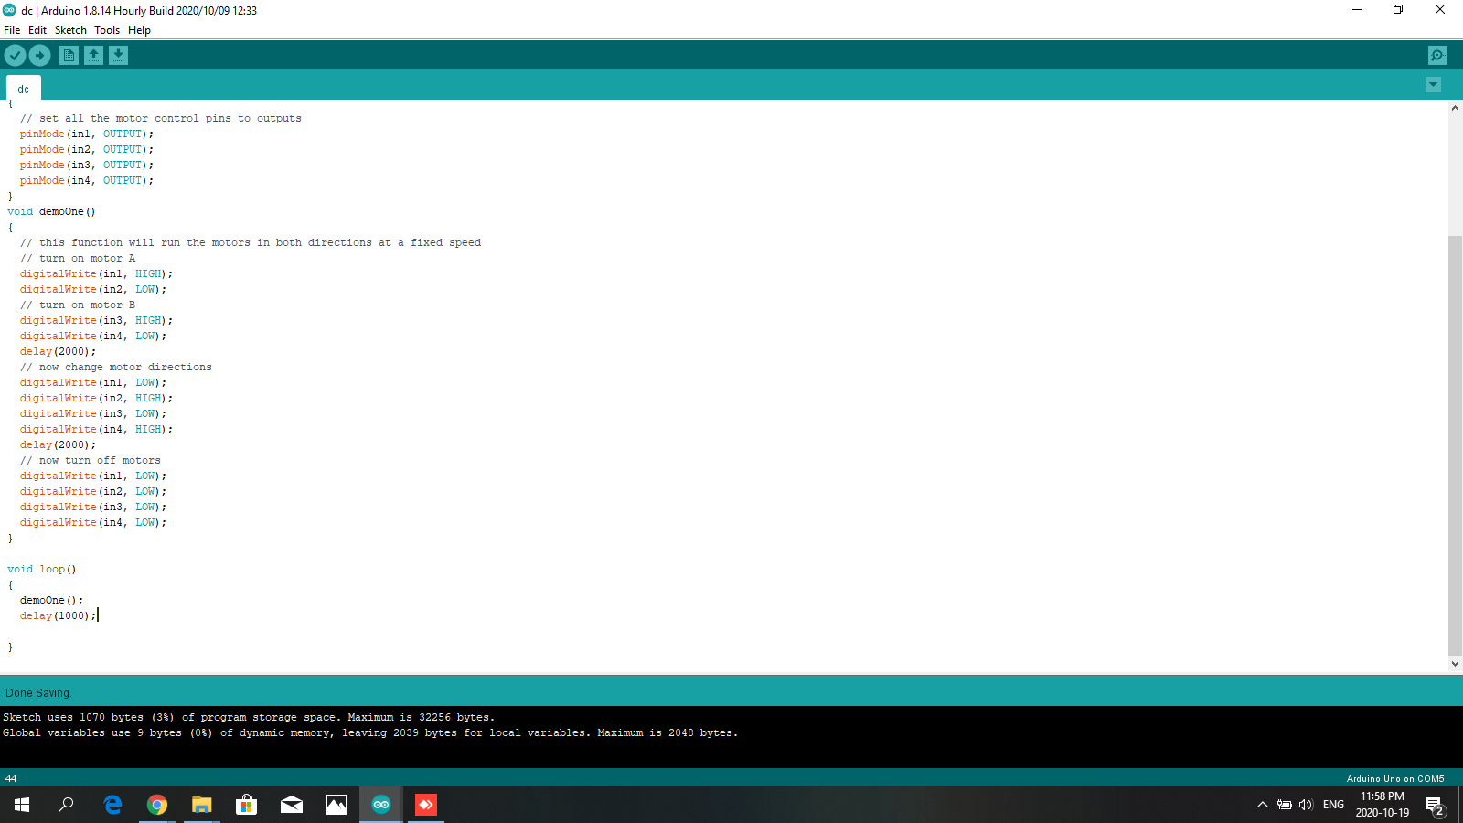

Slide 34
References
https://www.arduino.cc/en/main/software
https://components101.com/ultrasonic-sensor-working-pinout-datasheet
https://howtomechatronics.com/tutorials/arduino/ultrasonic-sensor-hc-sr04/
https://www.youtube.com/watch?v=ZejQOX69K5M
https://learn.sparkfun.com/tutorials/mlx90614-ir-thermometer-hookup-guide/all
https://www.youtube.com/watch?v=xVC0X_PE_XE
https://github.com/fmalpartida/New-LiquidCrystal
http://www.techydiy.org/how-to-connect-an-i2c-lcd-display-to-an-arduino-uno/
https://www.programmingelectronics.com/an-easy-way-to-make-noise-with-arduino-using-tone/

Slide 35
https://howtomechatronics.com/tutorials/arduino/arduino-dc-motor-control-tutorial-l298n-pwm-h-bridge/
https://www.youtube.com/watch?v=I7IFsQ4tQU8&t=174s
https://randomnerdtutorials.com/installing-the-esp32-board-in-arduino-ide-windows-instructions/

Slide 36
THANK YOU

